Slide 1
28/5/25

Slide 2
Darkcounts
Specs: <100 cps dark count rate.

Slide 3
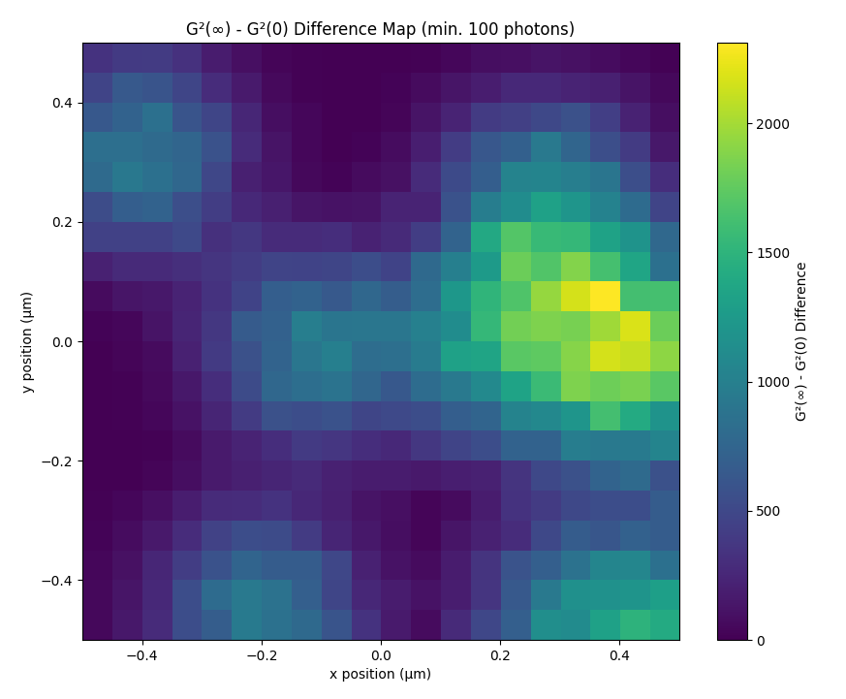

0 cps 1000 cps
Notes:
Number of dark counts per pixel is given by poisson distribution with expected value of darkcounts/pix * dwell time. With dwell time of 0.1ms, 100cps, this corresponds to average 0.23 darkcounts for whole detector per dwell

Slide 4
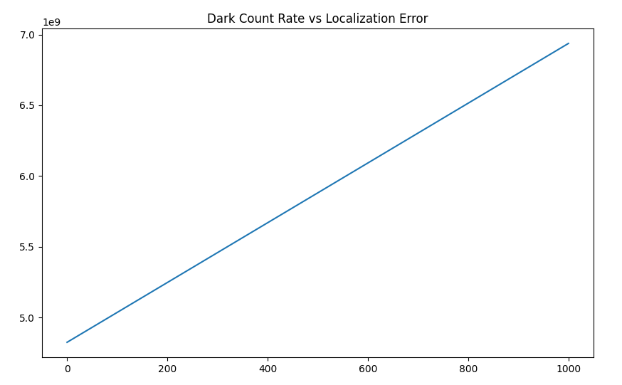
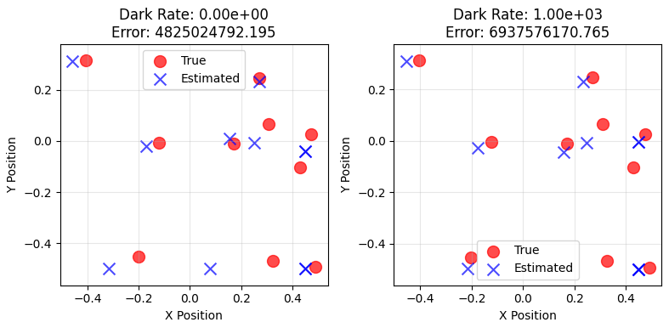

Slide 5
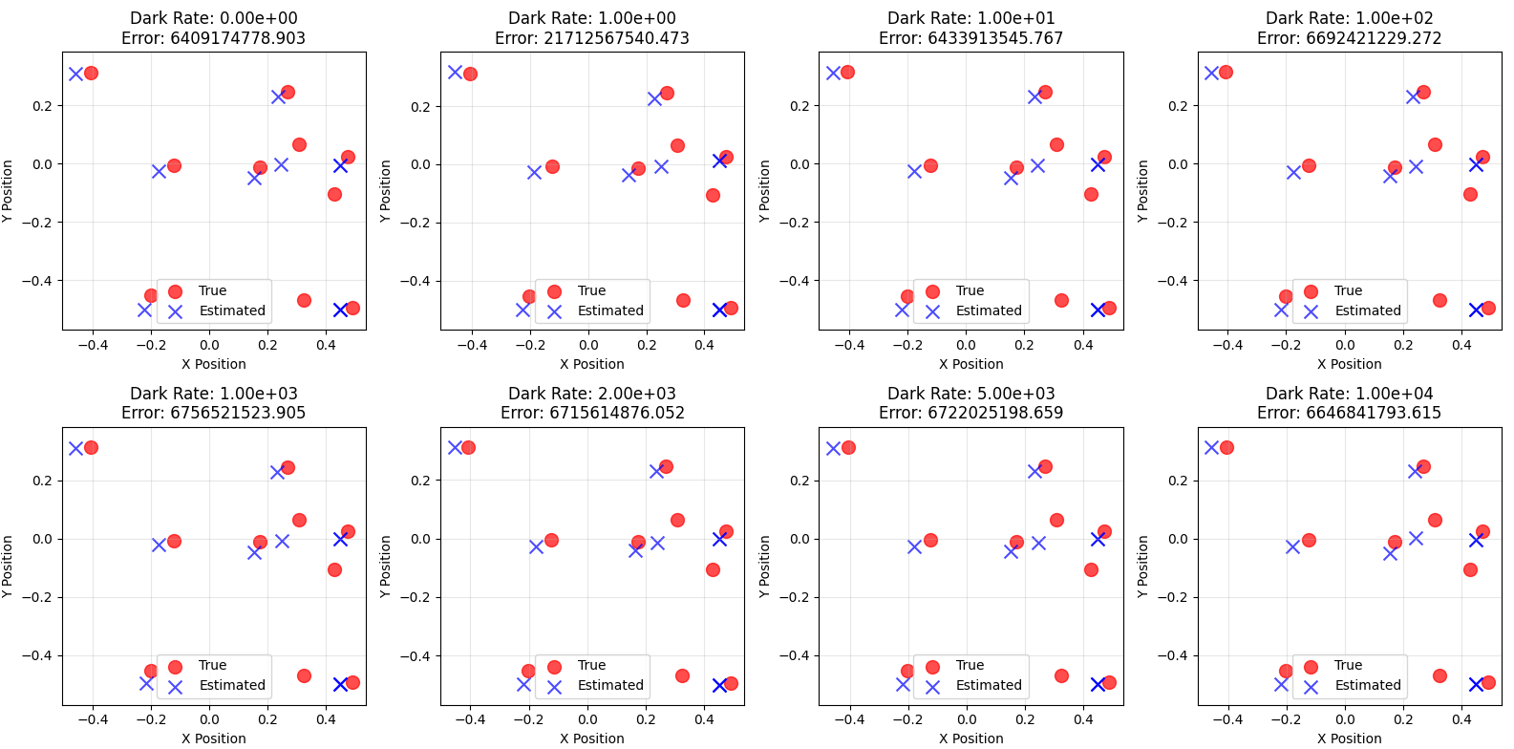

Slide 6
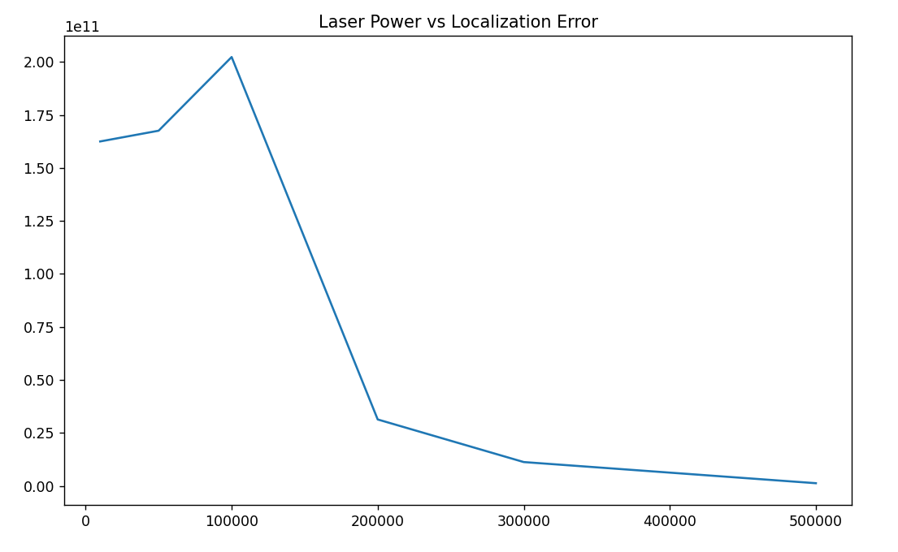
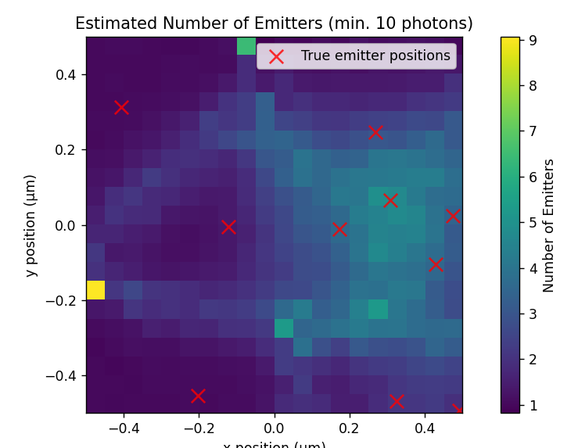
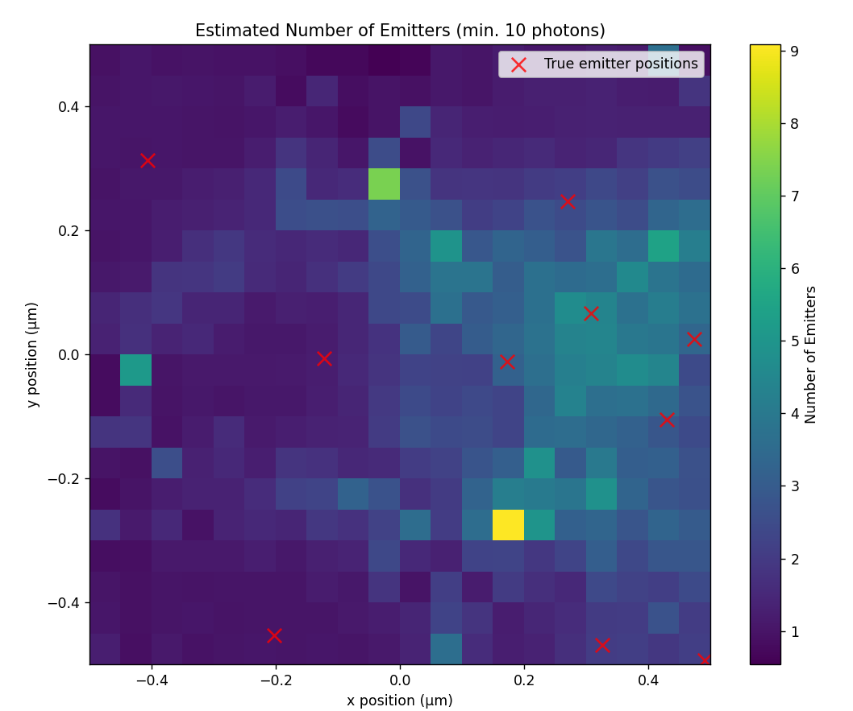
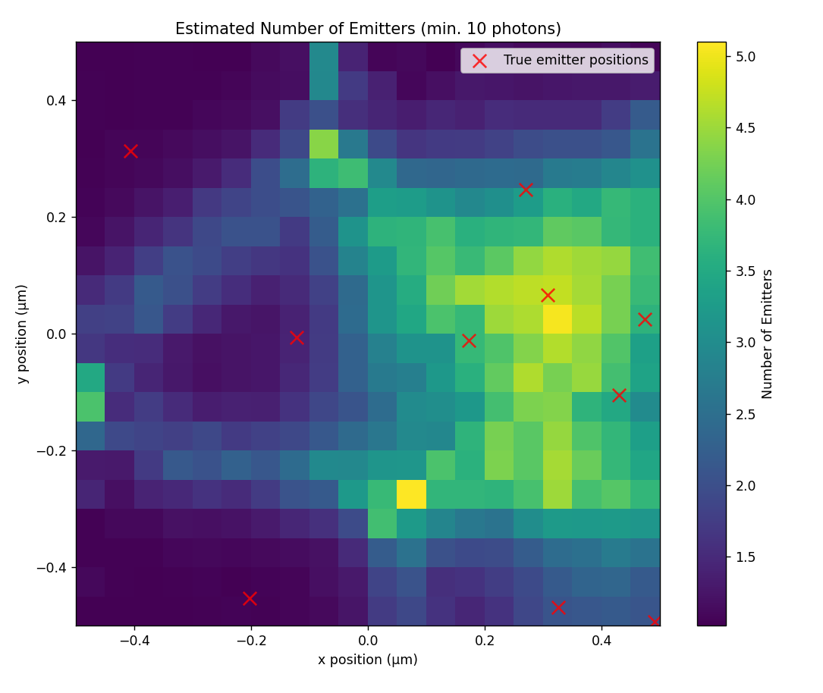
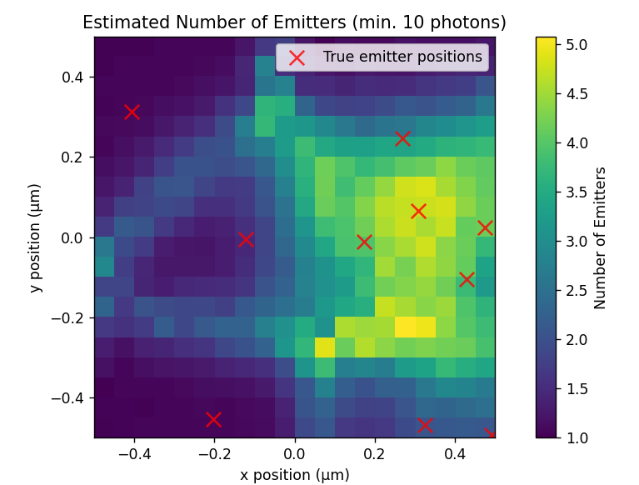
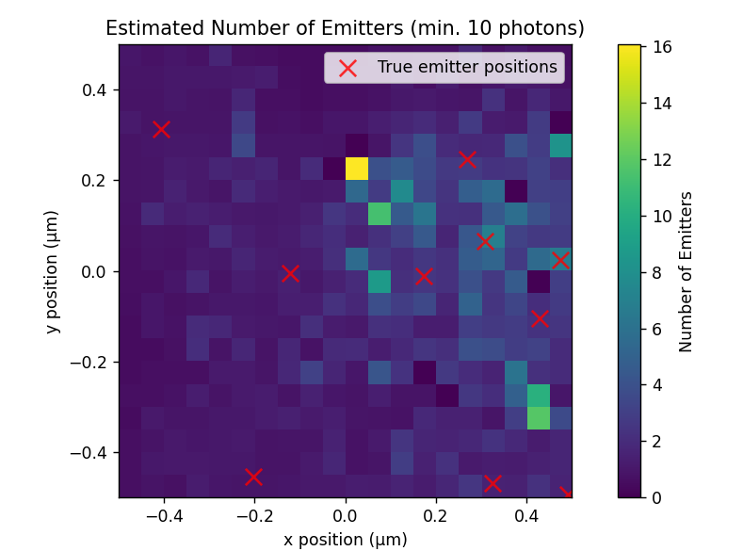
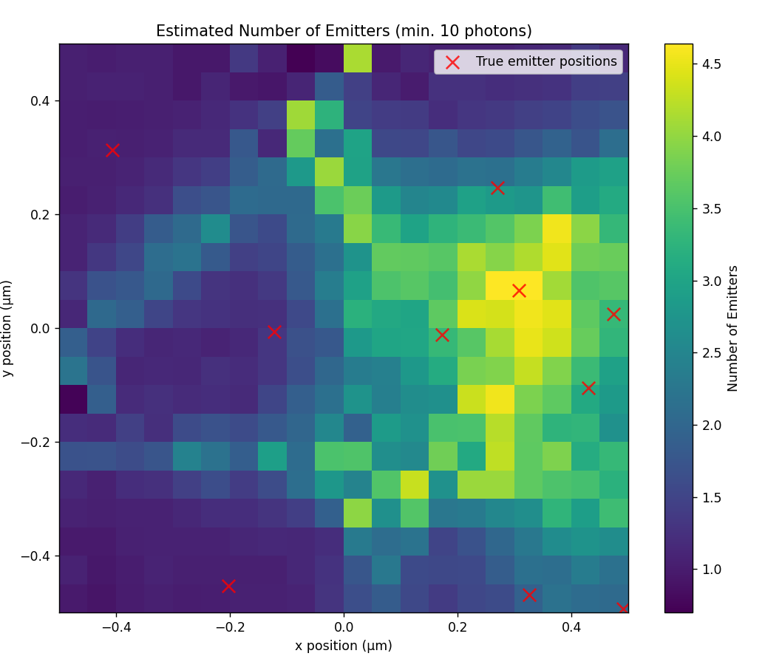
Notes:
10,50,100,200,300,500

Slide 7
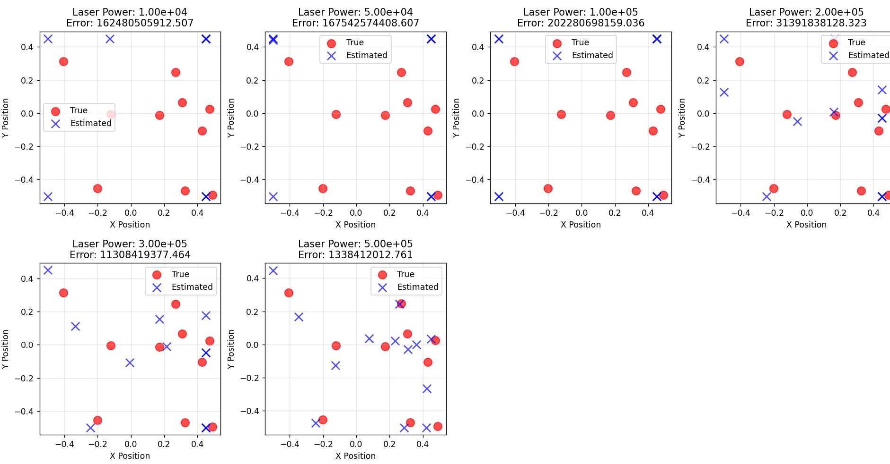
Avg 10 emitters / um^2

Slide 8
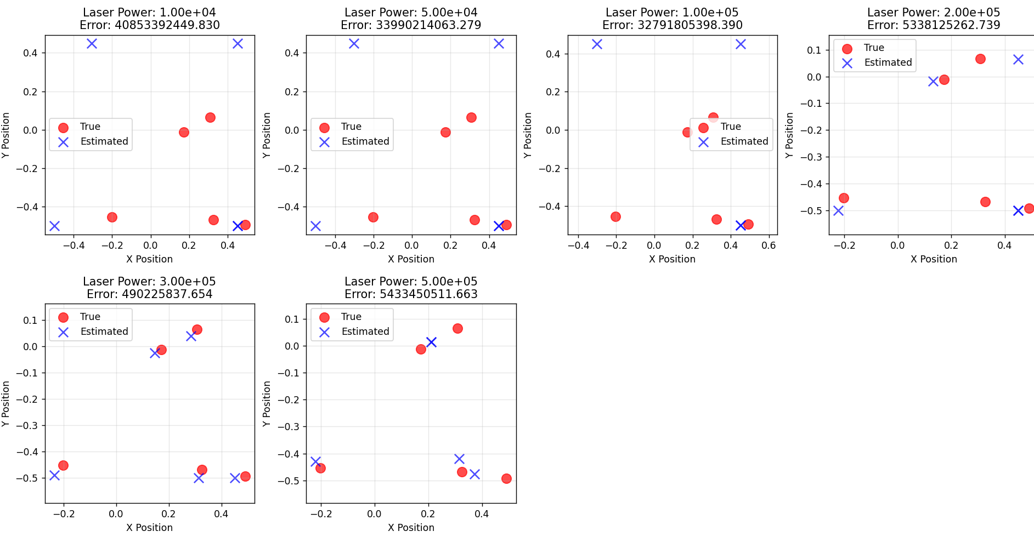
Avg 5 / um^2

Slide 9
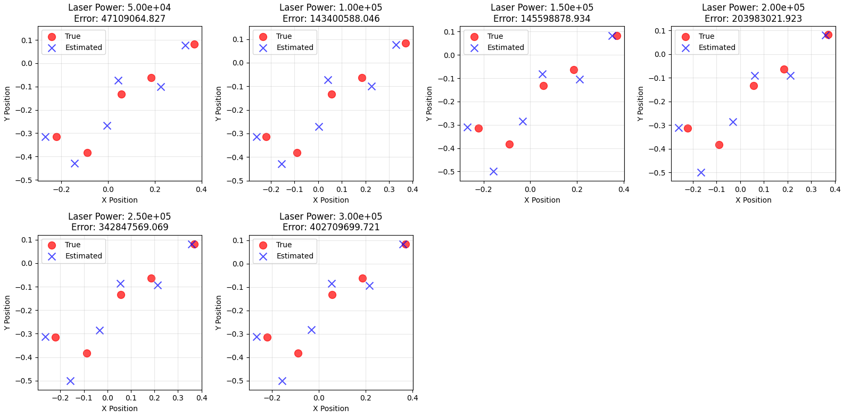
5 emitters per square micrometer

Slide 10
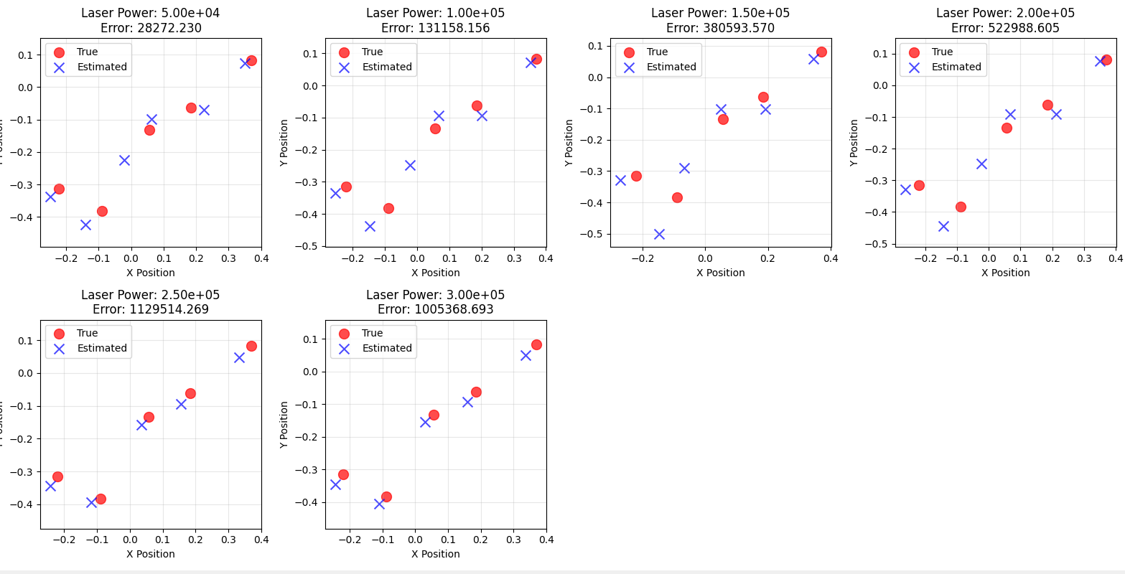
Same but now using only G2diff in optimization

Slide 11
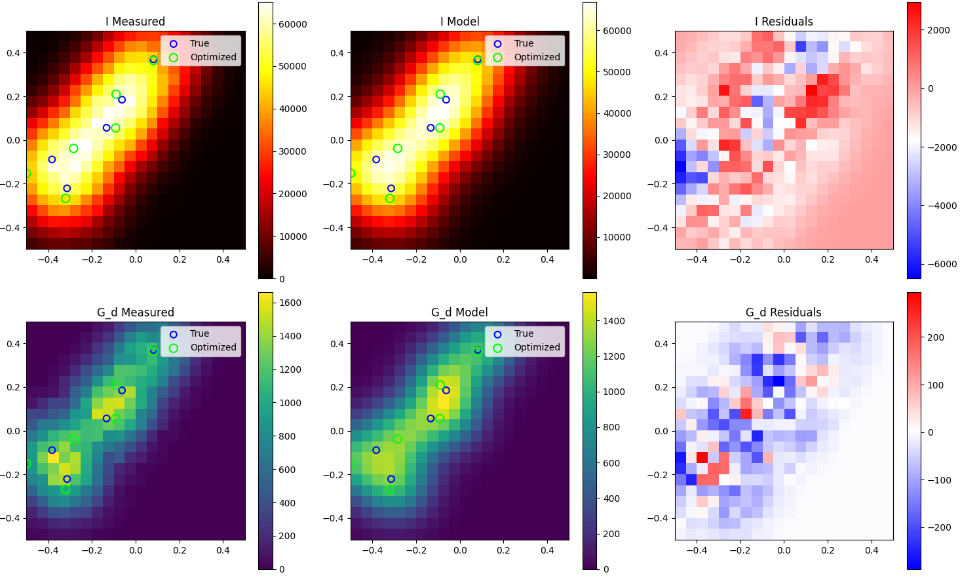
Possible improvement: adding regularization?
Notes:
Since it always overestimates the amount, not underestimates.

